Slide 1
Multilevel analysis of individual heterogeneity and discriminatory accuracy (MAIHDA) – using multilevel models to study intersectionality. Video 1 - Introduction to intersectionality.
Andrew Bell (University of Sheffield) Full resource: https://www.ncrm.ac.uk/resources/online/all/?id=20849

Slide 2
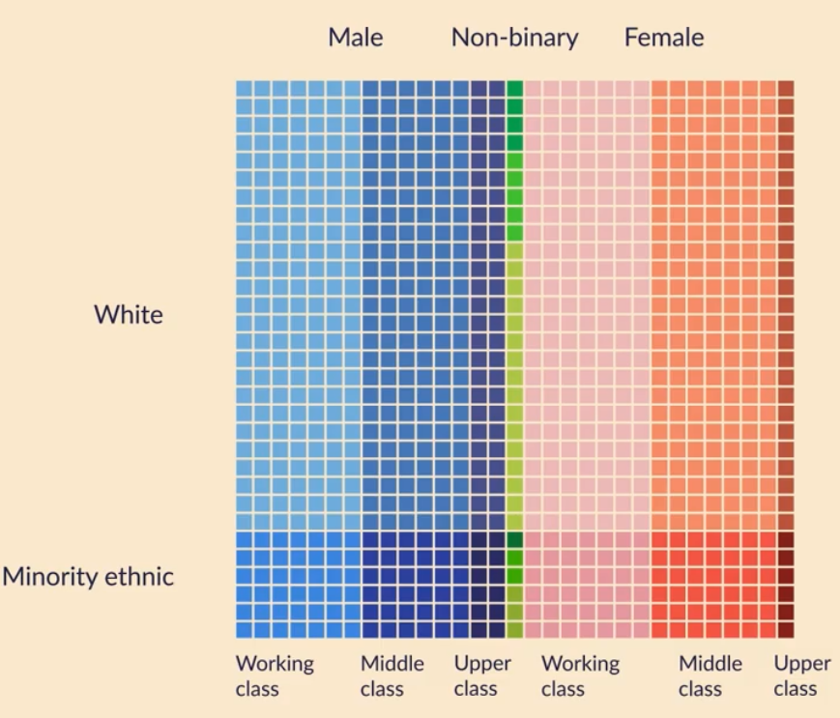
What is intersectionality
Two essential ingredients
Heterogeneity
Our identity is more than just the sum of our various characteristics

Slide 3
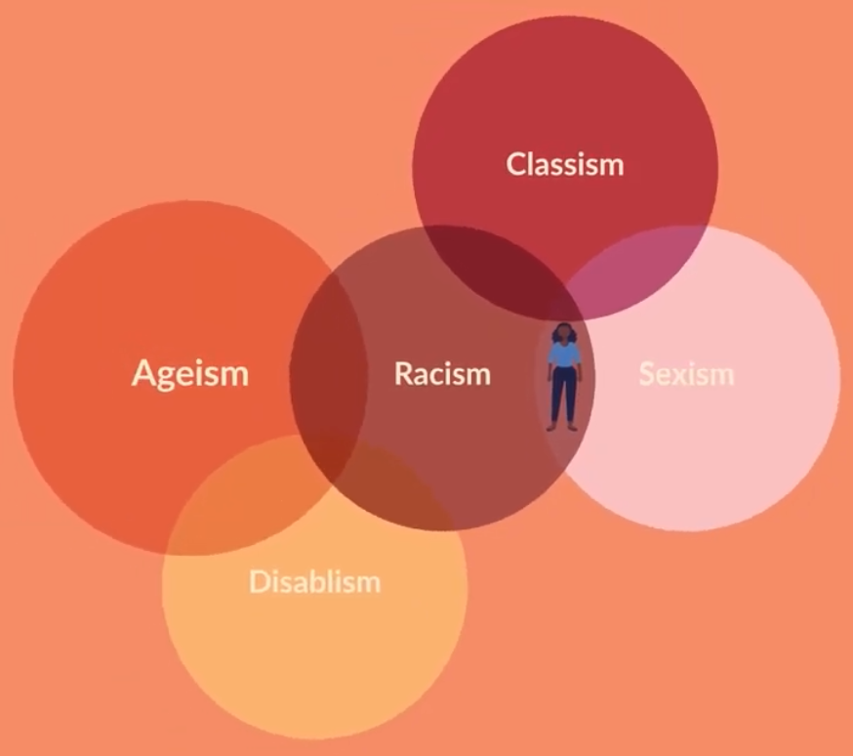
What is intersectionality
Two essential ingredients
Heterogeneity
Social Power
Social processes and hierarchies produce disadvantage in complex ways, meaning multiple disadvantages interact

Slide 4
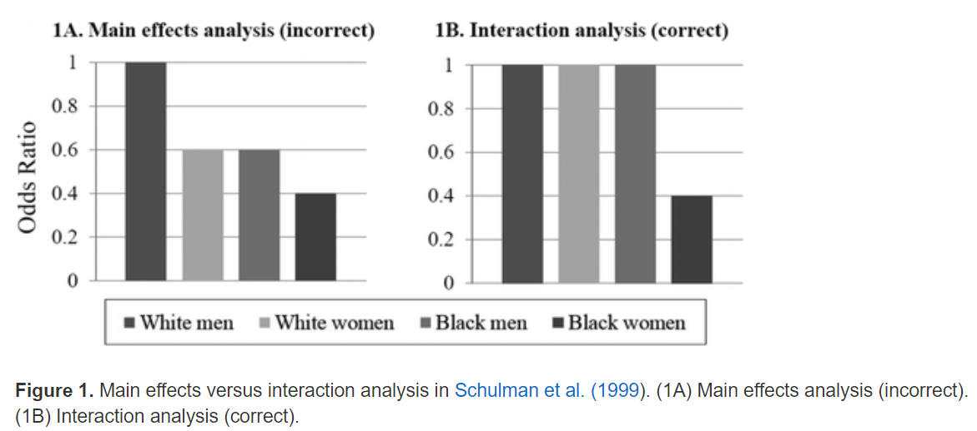
What is intersectionality
Understanding the ways that different dimensions of inequality compound themselves (Kimberlé Crenshaw)
Eg Race and Sex

Slide 5
What is intersectionality
Intersectionality often thought of as a concept for qualitative research – but it originated in the quantitative realm (see previous slide)
How might we use quantitative methods to uncover intersectional differences?

Slide 6
www.ncrm.ac.uk

